Slide 1
Security Intelligence
in Azure Sql PaaS

Slide 2









GOLD SPONSORS
SILVER SPONSORS
BRONZE SPONSOR
STRATEGIC PARTNER

Slide 3
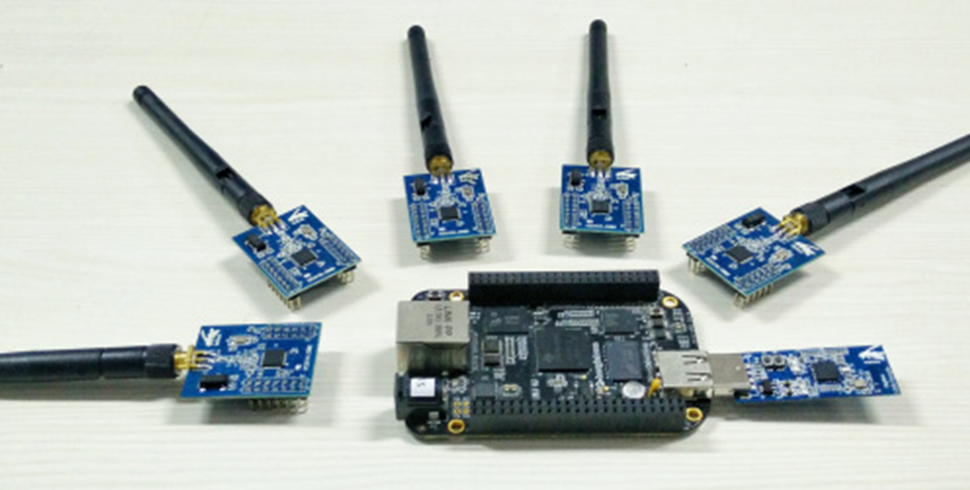

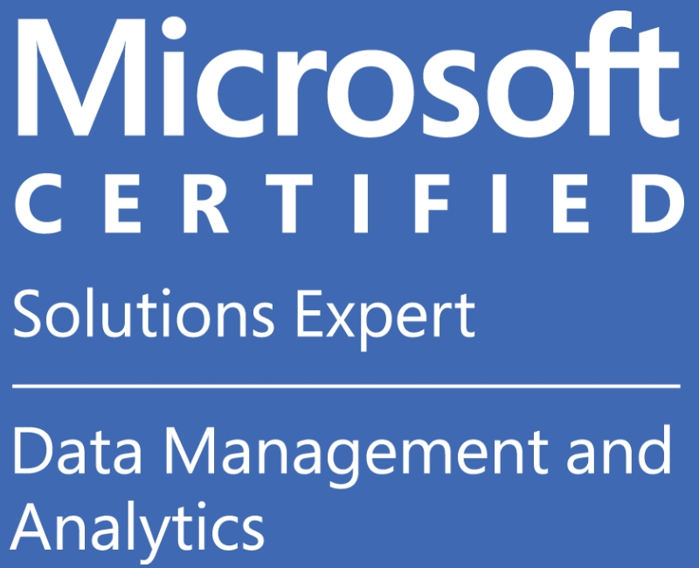
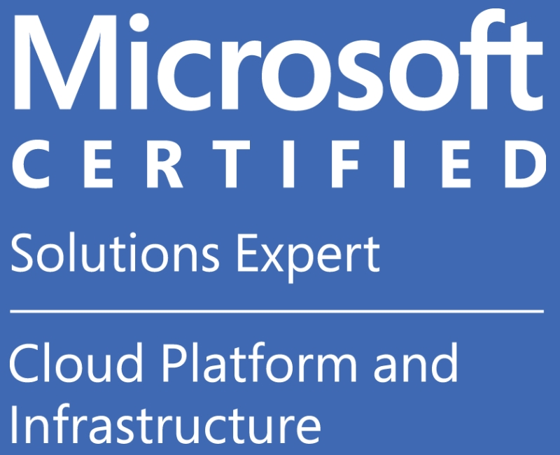
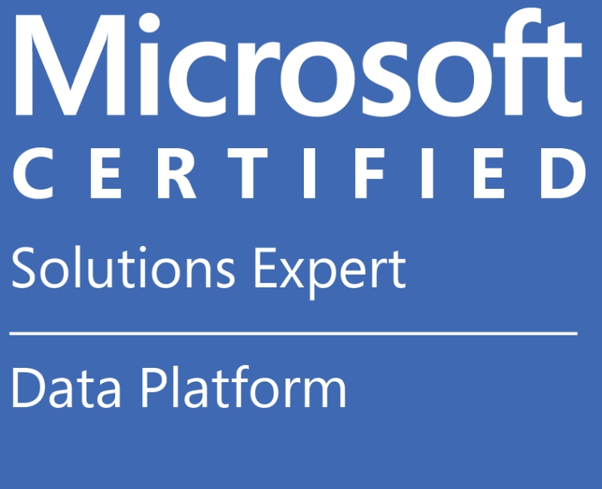

About Me
Notes:
IoT and Edge Computing
Incredibly Low Latency

Slide 4
Agenda
General Definitions
8 stage journey through Azure Sql PaaS security intelligence
Start: Azure Security Practice
End: Security functions automation

Slide 5





Attack Defence

Slide 6
Intelligence
Ion Stoica
Good decision:
Based on most recent data
Faster is better than slower
Personalised
Robust
Explainable

Slide 7
Decisions
IGNORE
ACKNOWLEDGE
OUTSOURCE
ACT

Slide 8





Demo

Slide 9







Azure Sql PaaS
SQL Database
Azure Cosmos DB
SQL Data Warehouse
Azure DB for PostgreSQL
SQL Elastic database pool
Azure DB for MySQL
SQL Managed Instance

Slide 10
Understanding
Azure security practice

Slide 11
Shared responsibility matrix
 | Prem | IaaS | PaaS | SaaS
Data classification & accountability
Client and end-point protection
Identity & access management
Application level controls
Network controls
Host infrastructure
Physical Security

Slide 12

SQL Server
2017
SQL Database
SQL Managed
Instance
RDP to server
Windows patching
SQL Server patching
Account for services
SA account
Strong passwords
xp_cmdshell
Trustworthy
Cross-db queries
CLR
-
-
-
-
-
-
-
-
-
-
-
-
-
-
-
-
--

Slide 13
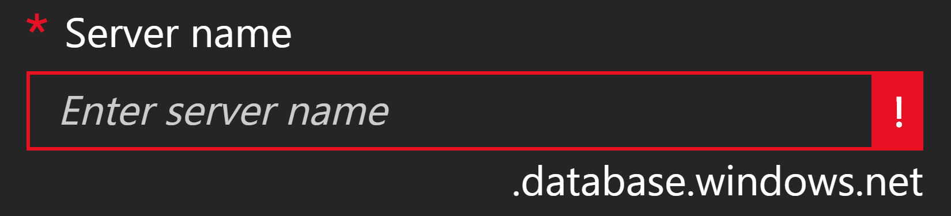
Public cloud philosophy
PsPing/Test-NetConnection ~1700

Slide 14
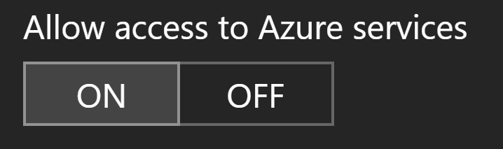
Public cloud philosophy
99%

Slide 15
Building strong compliance foundations

Slide 16
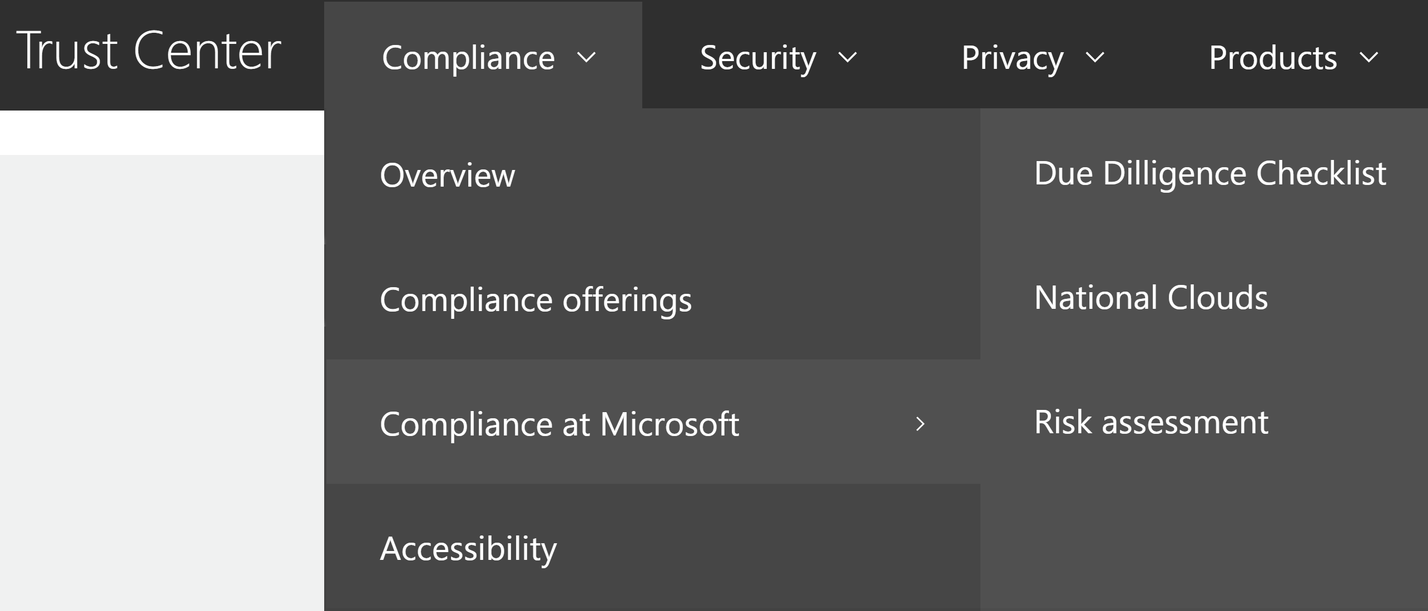
Microsoft compliance
TDE is enabled by default.
Why?
To encrypt data at rest.
Why?
It's recommended by Microsoft.
Why?
To improve security.
Why?
To build TRUST.
Why?

Slide 17
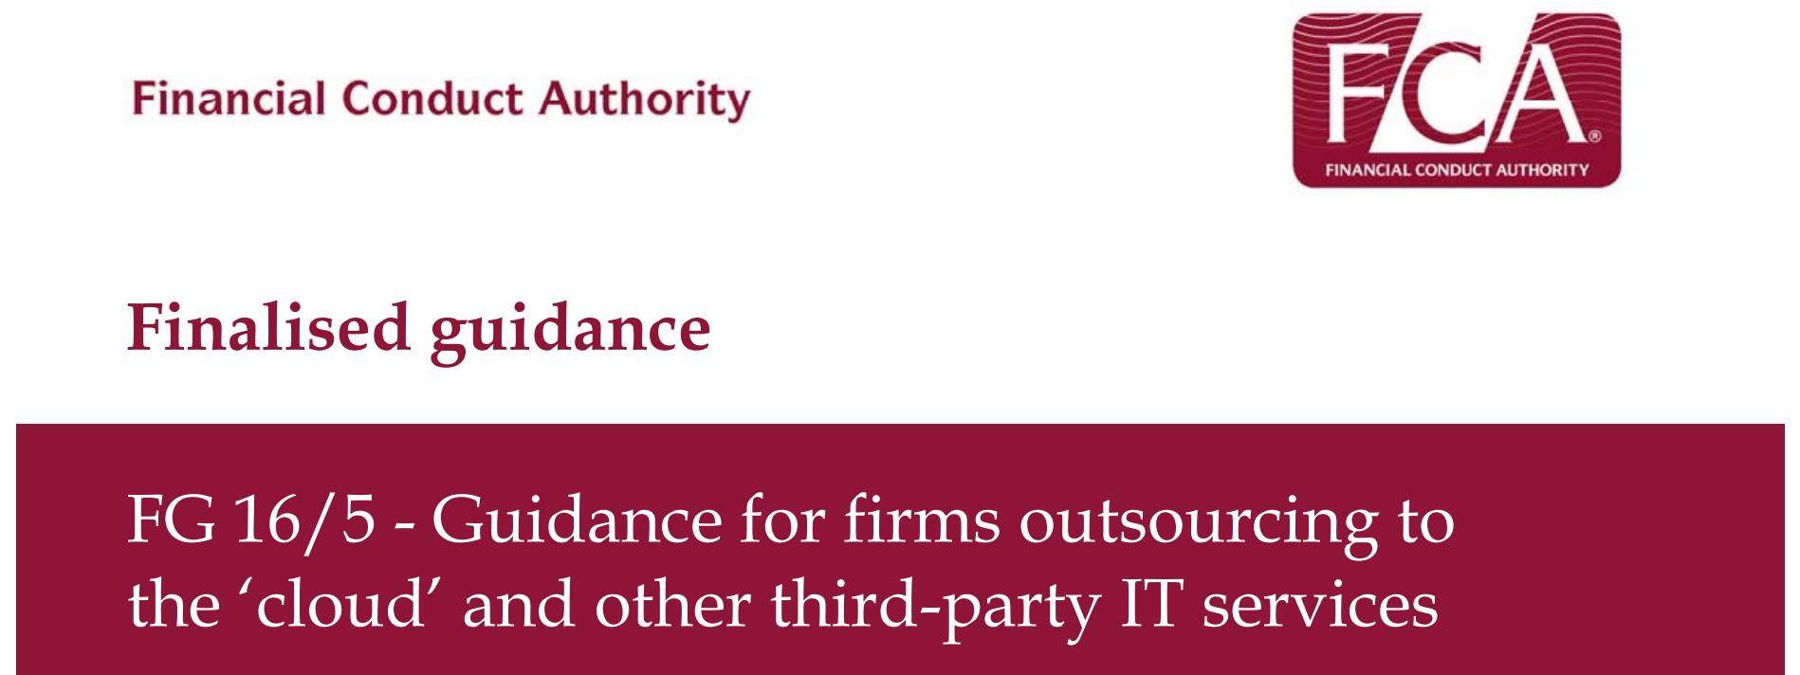
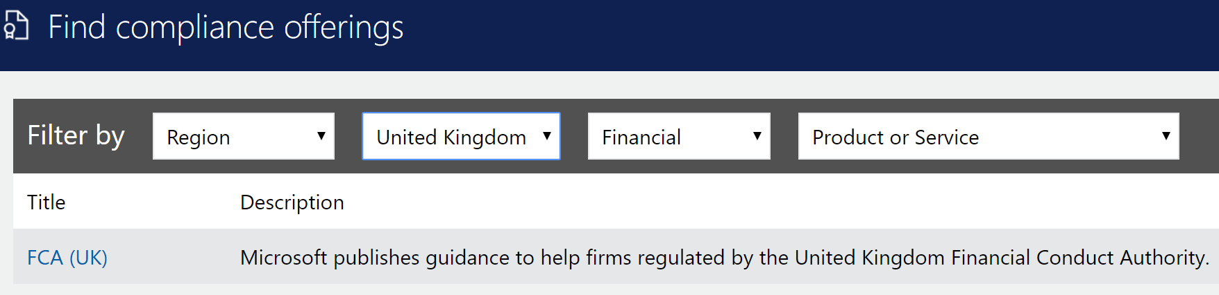
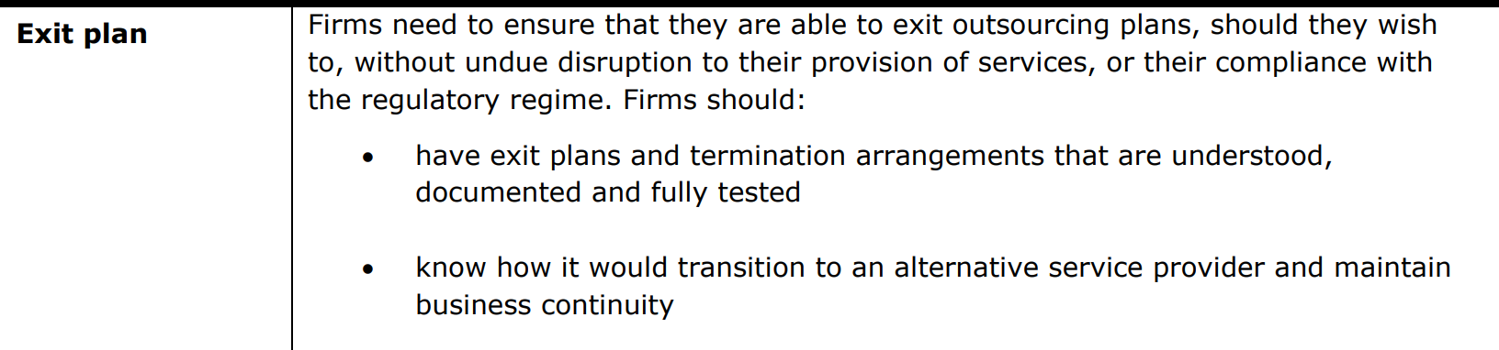
Azure SQL PaaS compliance

Slide 18
Integrating
IAM

Slide 19
Azure Active Directory
Azure AD Connect
Conditional Access
Privileged Identities
B2C
AAD DS
Security Graph
RBAC
B2B
Devices
Trusted IPs
Apps
Proxies
JIT Access
MFA
Named Locations
(…)

Slide 20
AAD Integration
Server
[MI only] Run PS script to grant read access to AAD
Set AAD User/Group as Server Admin
Add accounts using above principal
Client
Authentication=
Active Directory Integrated Active Directory Password
connection.AccessToken
.NET 4.6, ADALSQL.DLL
Limitations: bcp.exe, PolyBase, SSDT

Slide 21
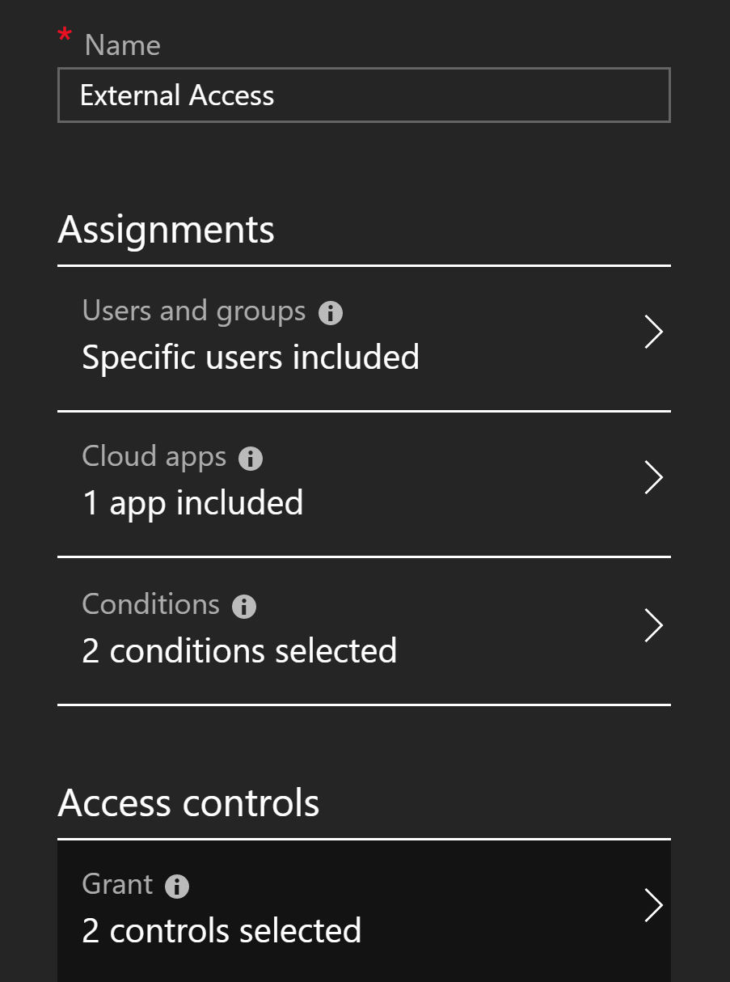
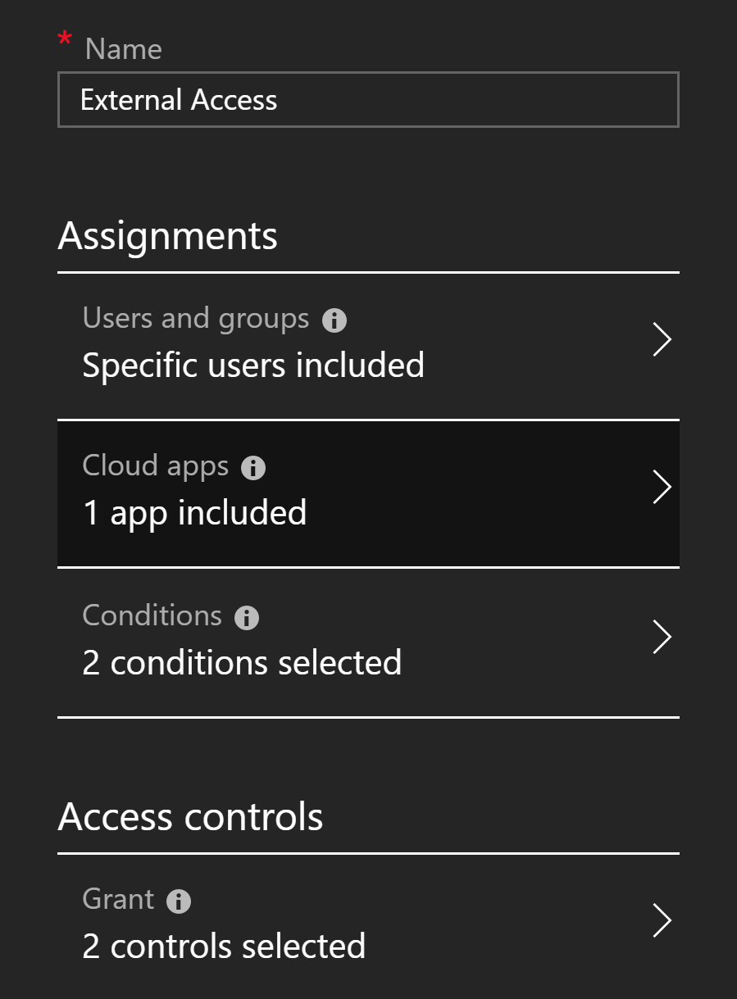
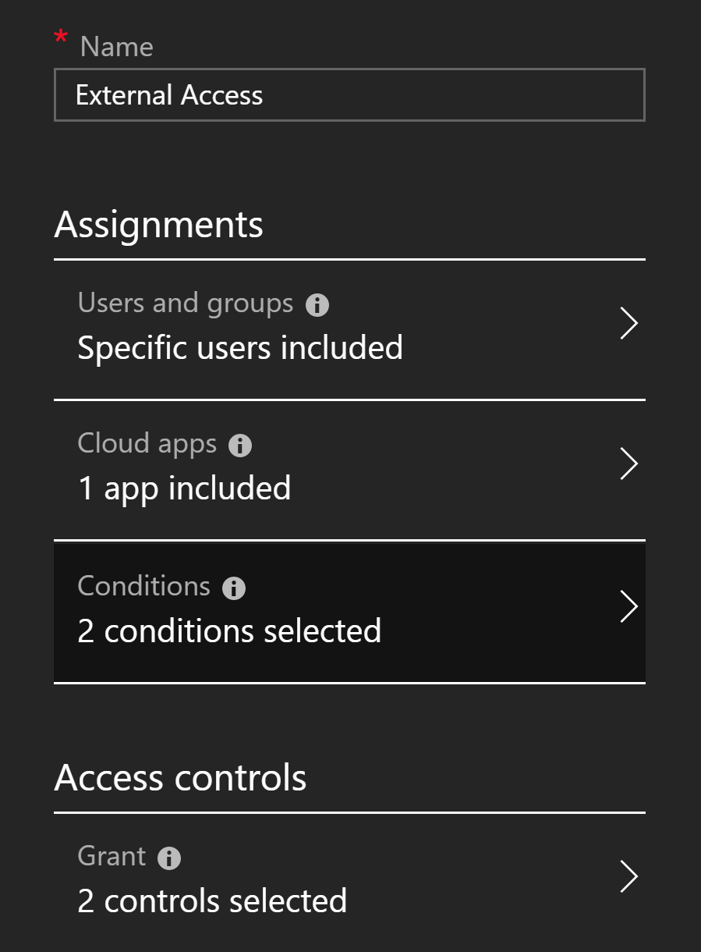
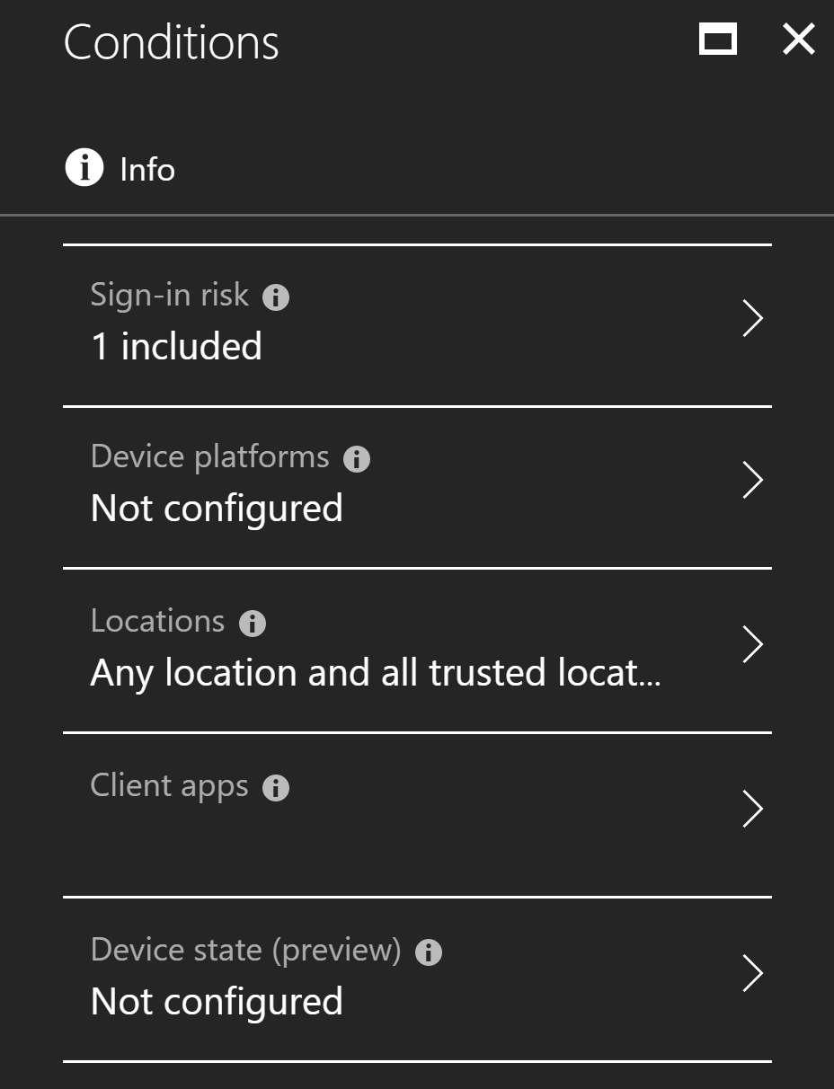
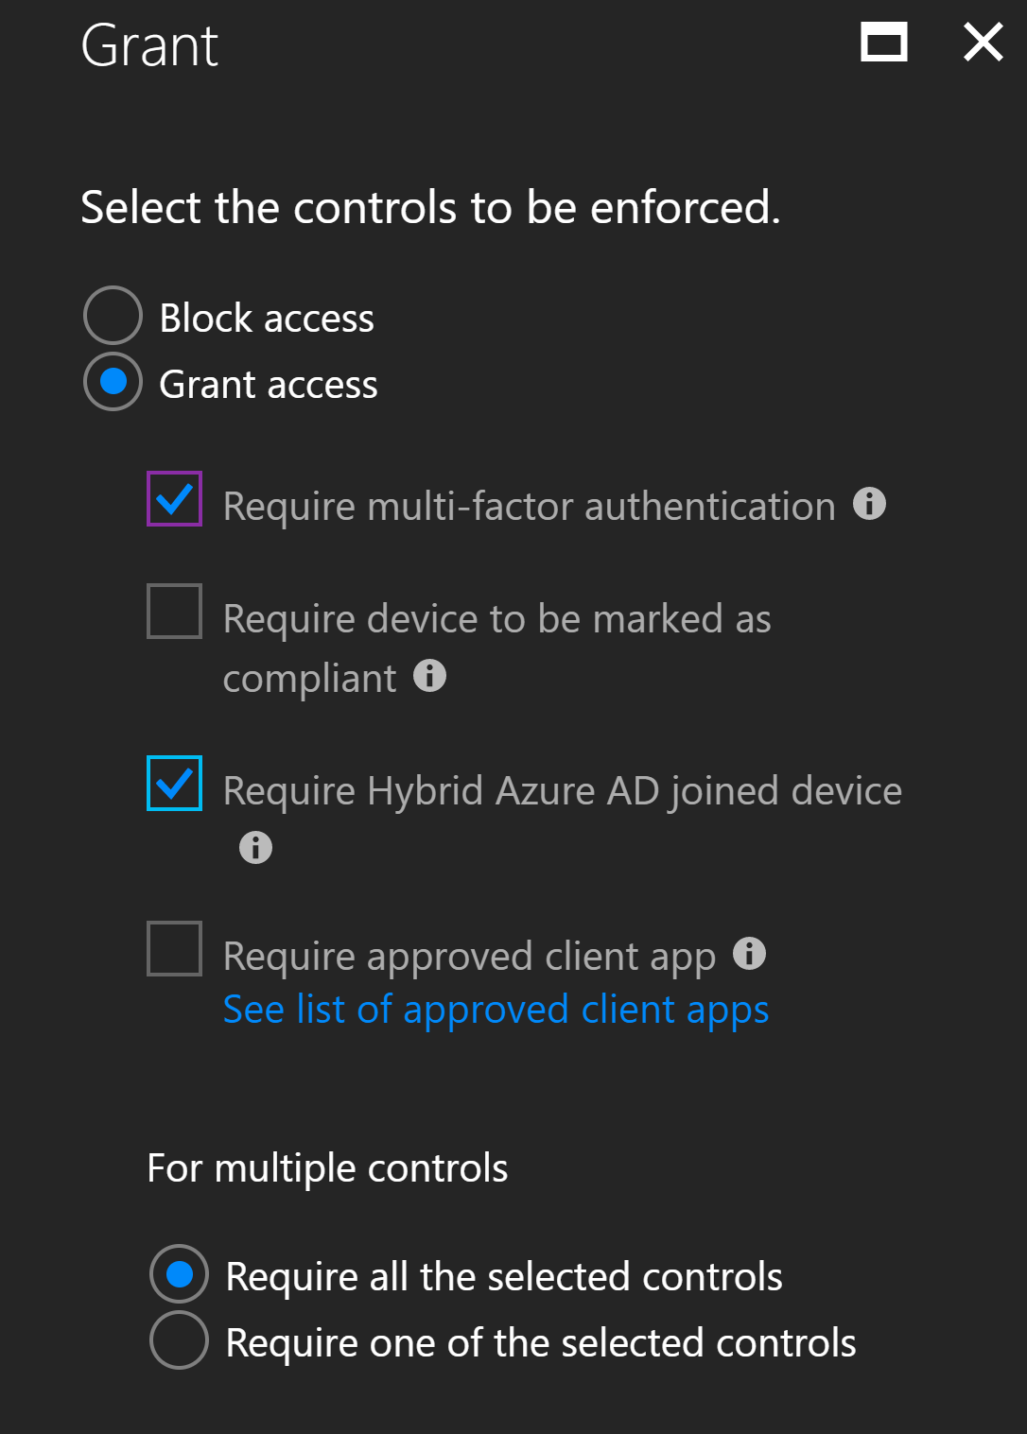
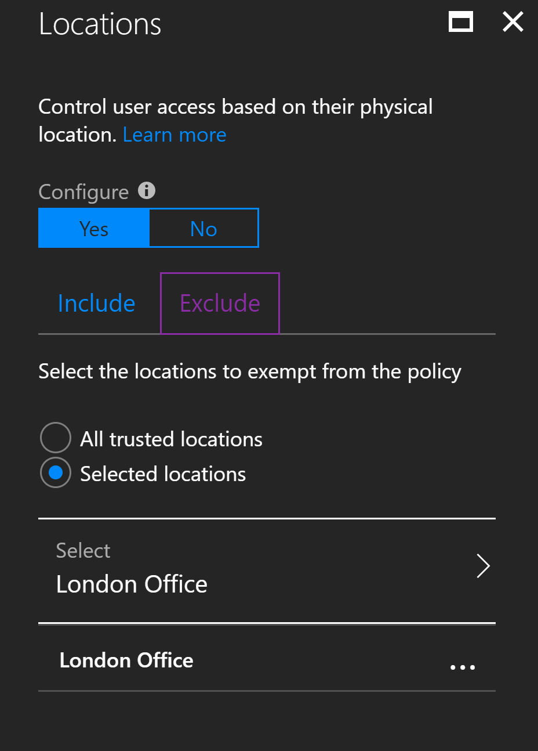
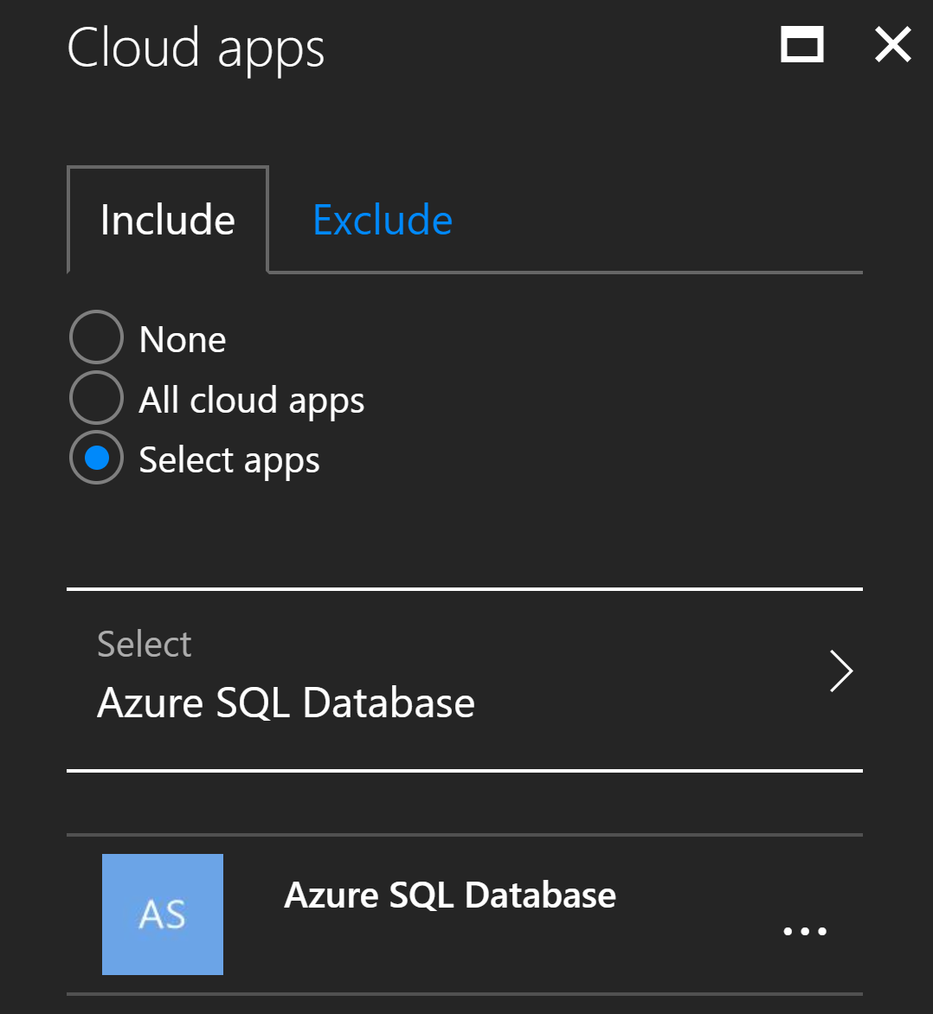
AAD Conditional Access

Slide 22
Enabling
detective
controls

Slide 23

Threat Detection
INPUT:
Dynamic data - logins, batch requests
OBJECTIVE FUNCTION:
Detect Threats
OUTPUT:
Notifications

Slide 24
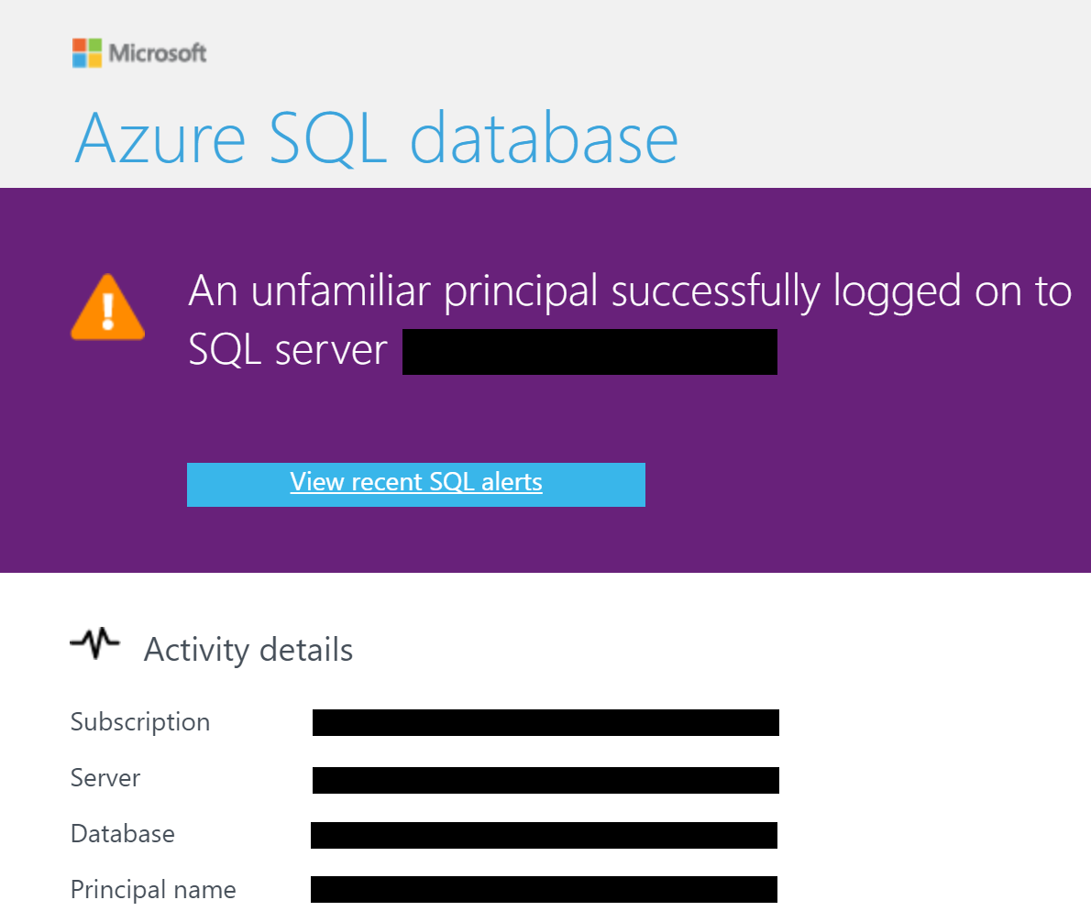
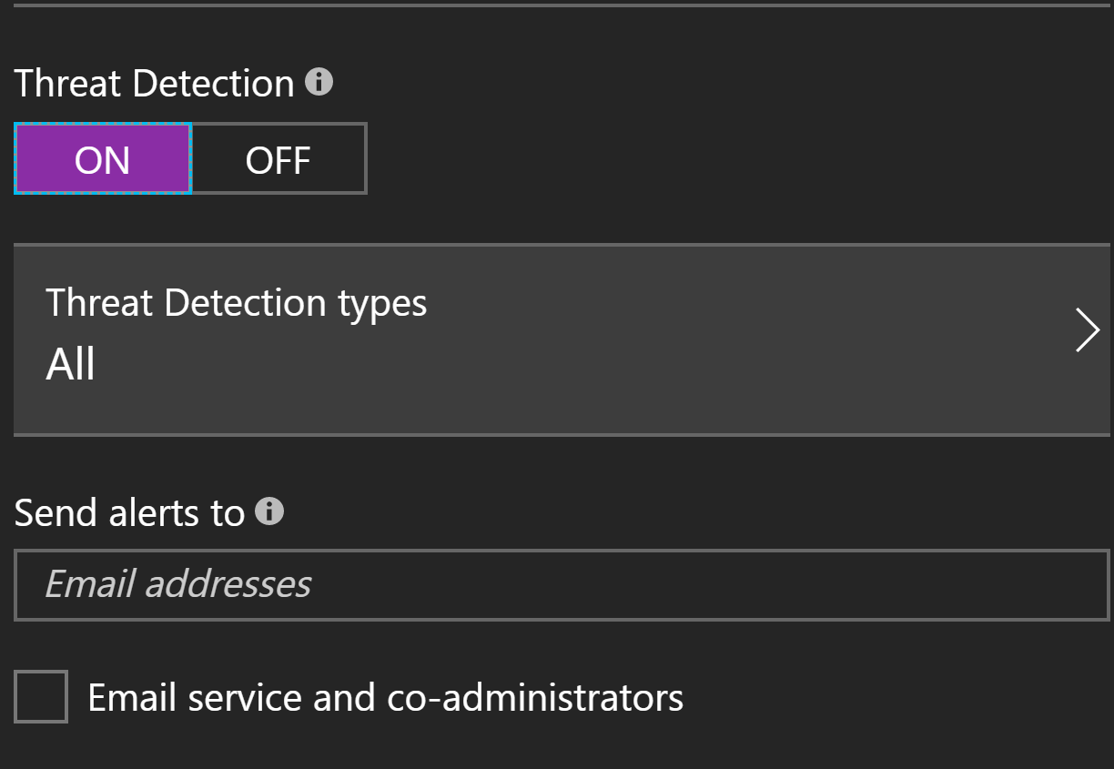
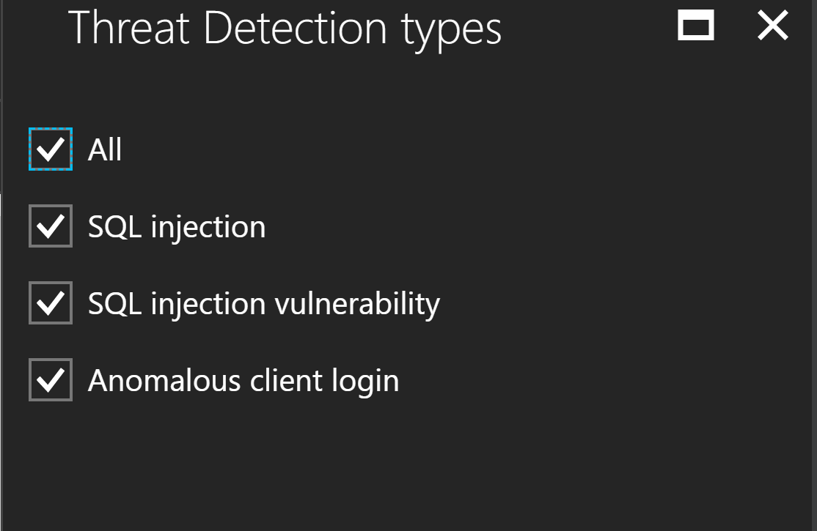
Threat Detection

Slide 25

Vulnerability Assessment
INPUT:
Security configuration – static data
OBJECTIVE FUNCTION:
Assess Risk
OUTPUT:
Security Recommendations

Slide 26
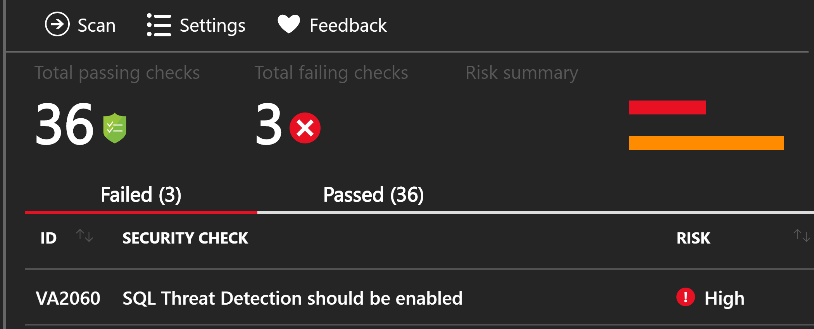
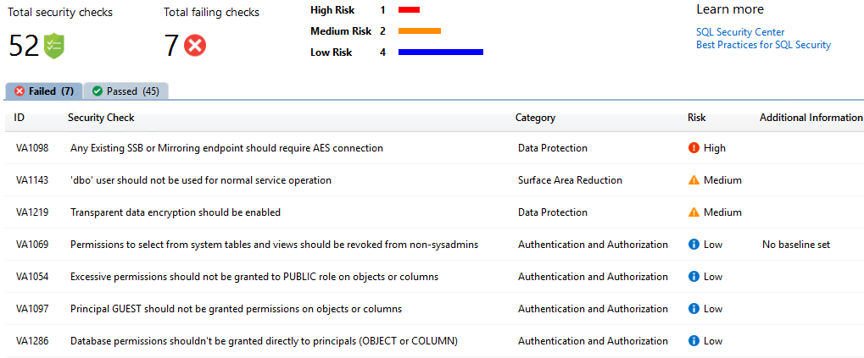
Vulnerability Assessment

Slide 27

INPUT:
Static (security configuration) and dynamic (activity)
OBJECTIVE FUNCTION:
Prevent, detect and respond
OUTPUT:
Recommendations

Slide 28
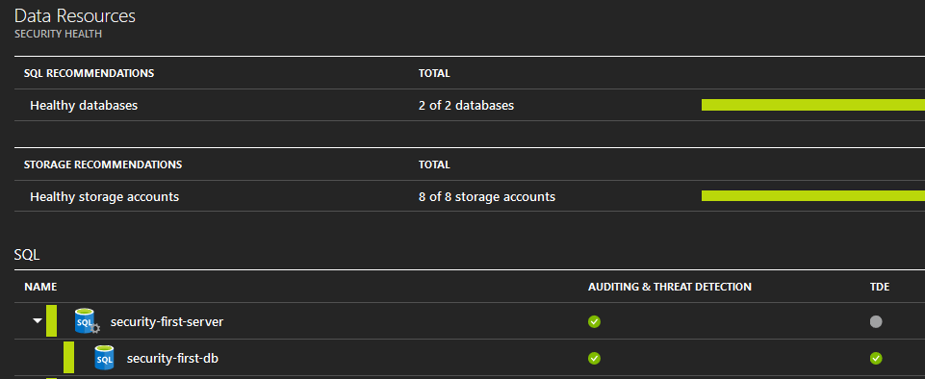

Slide 29
Establishing
network
security

Slide 30
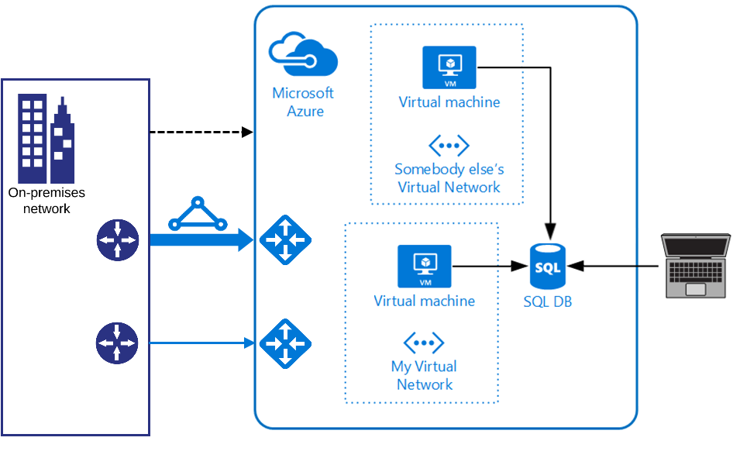


Azure Sql Database

Slide 31
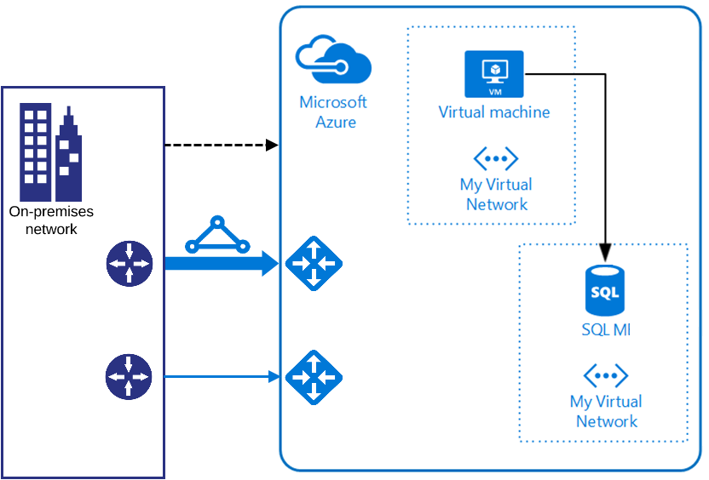
Azure Sql Managed Instance

Slide 32
Implementing
data
protection

Slide 33
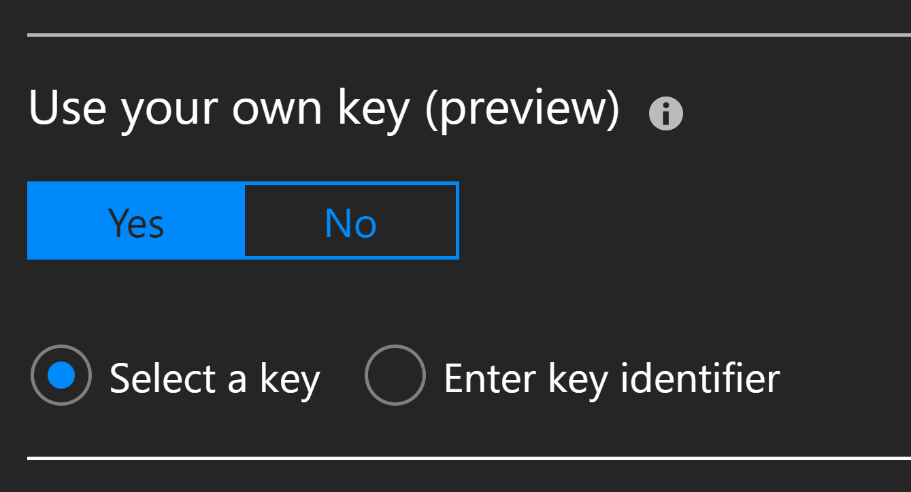
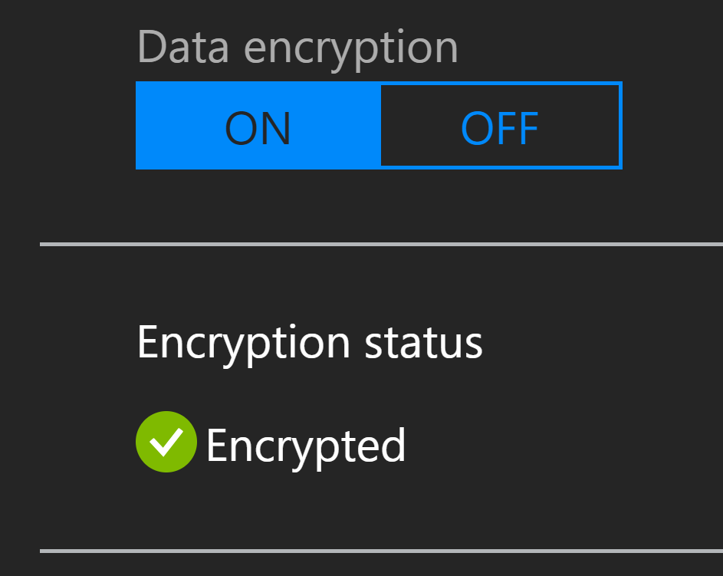
TDE

Slide 34

INPUT:
List of columns – static data
OBJECTIVE FUNCTION:
Assign sensitivity label
OUTPUT:
Data Classification

Slide 35
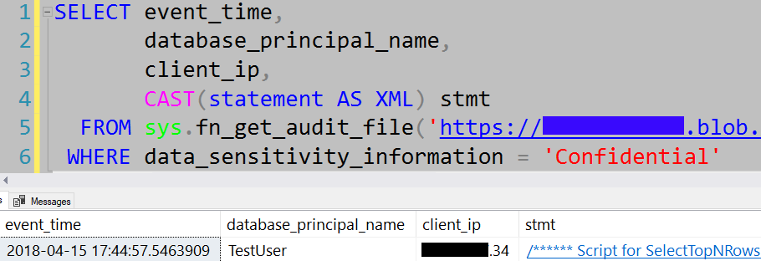
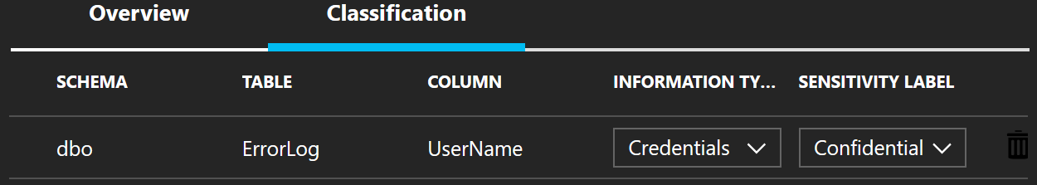

Slide 36
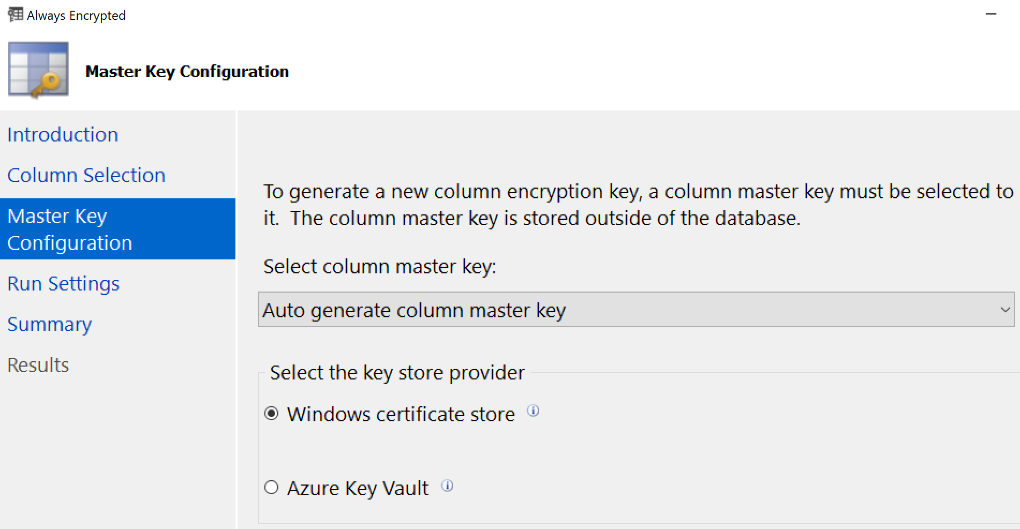

Always Encrypted

Slide 37
Optimising
change
management

Slide 38
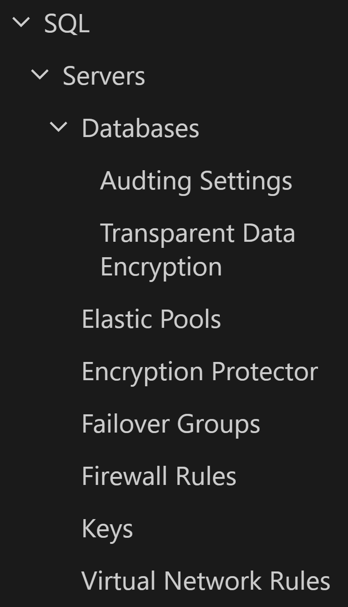
ARM templates
How to secure template?
How to secure parameters?
Cross resource group deployment?
How to find parameters?

Slide 39
Azure Policy
Production Sql Server Initiative
Location Policy
Prevent any Sql resources
Exclude dedicated RG
Production Sql Server Policy
Enforce Delete lock
Enforce contactPerson tag
Azure Policy | RBAC
Resources | Users
Default Allow | Default Deny

Slide 40
Automating
security
functions

Slide 41
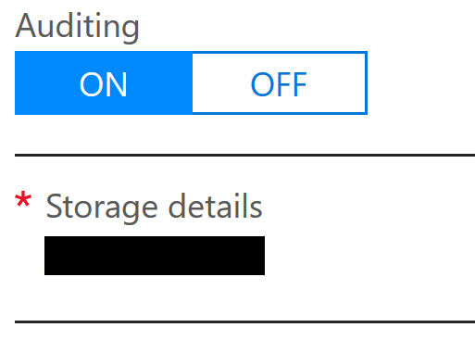

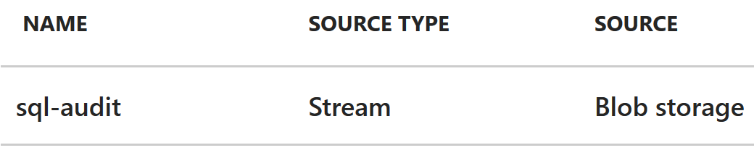
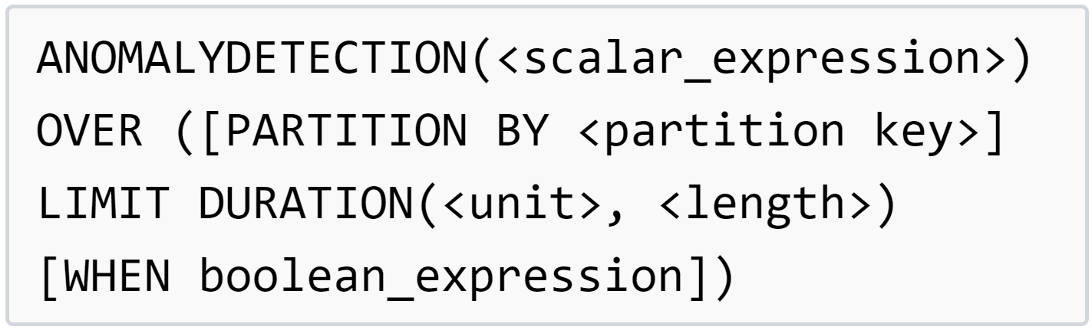

Unsupervised Anomaly Detection

Slide 42
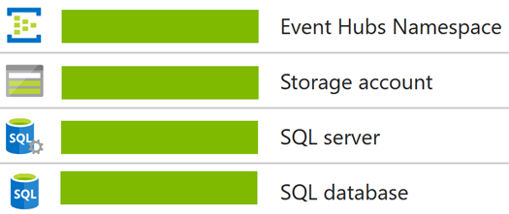
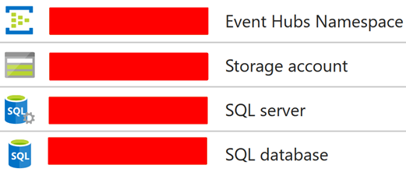
Detecting Lateral Movement

Slide 43
Understanding Azure security practice
Building strong compliance foundations
Integrating IAM
Enabling detective controls
Establishing network security
Implementing data protection
Optimising change management
Automating security functions

Slide 44
THANK YOU
LinkedIn /jrokicki
@DataSic
www.DataSic.com

